Slide 1
Policy Based Management 101
Jorge Segarra
Email: jorge@sqlchicken.com
Blog: http://sqlchicken.com
Twitter: http://twitter.com/sqlchicken

Slide 2
University Community Health
Serving Tampa since 1968, started with 208-bed facility
Today: UCH-Main Campus (Fletcher, 357-bed facility), UCH-Carrollwood, Pepin Heart Hospital, Women’s Center, Breast Care Center, Helen Ellis Memorial Hospital, LTAC + various Physician Care branches
~4,000 End users
IT Dept 40-50; 15 in Technical Services
Over 400+ applications!
~100+ SQL Servers (2000/05/08)
  Almost 50% virtualized!

Slide 3
Agenda
What is PBM
Architecture
Demos/Examples
Questions

Slide 4
What is PBM?
A system for managing one or more instances of SQL Server 2008* (BOL)
  *Can manage 2000/2005 as well

Slide 5
Why Policy Based Management?
Ease of Management
  CMS (Req. SQL 2008 Std or higher)
Consistency
  Apply policies across multiple servers
  Policy control on SQL 2000 and higher*
Control
  Compliance (HIPAA,SOX)
  Prevent / Notify Changes
“Free”
*Not all features/policies apply on < 2008

Slide 6
Model / Architecture
Policies
  Includes condition/expected behavior
  Desired state / what targets / when to check
  Can only contain one condition
Conditions
  Boolean Expression specifies target type
  i.e. Name LIKE ‘sp_%’
Facet
  Logical dimension properties
Category
  Classification to help manage policies.
  1 Category per Policy
Notes:
MSDB is the policy store

Slide 7
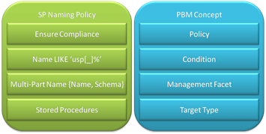
Model / Architecture

Slide 8
Key Features
Policies
Expressive conditions
Facets
Ad hoc evaluation
Policy Automation
Policy Violation Alert
Policy Health
Policy Category
Create Policy from State
Multiple Server Mgt
Non-DB Engine Support
Surface Area configuration facets
Down-level Support
2000 and above
Out-of-Box Best Practices (demo)

Slide 9
DEMO

Slide 10
Resources
Download SQL 2008 Enterprise(180 days)
  http://www.microsoft.com/sqlserver/2008/en/us/trial-software.aspx
Free SQL 2008 Hosted Test Labs
  http://sqlserverbeta.com
SQLPBM Blog
  http://blogs.msdn.com/sqlpbm/default.aspx
Using PBM in SQL 2008 (Hongei Guo)
  http://tinyurl.com/ll2kzw
MSDN
  http://msdn.microsoft.com/en-us/library/bb510667.aspx
Enterprise Policy Mgt Framework
  http://epmframework.codeplex.com/

Slide 11
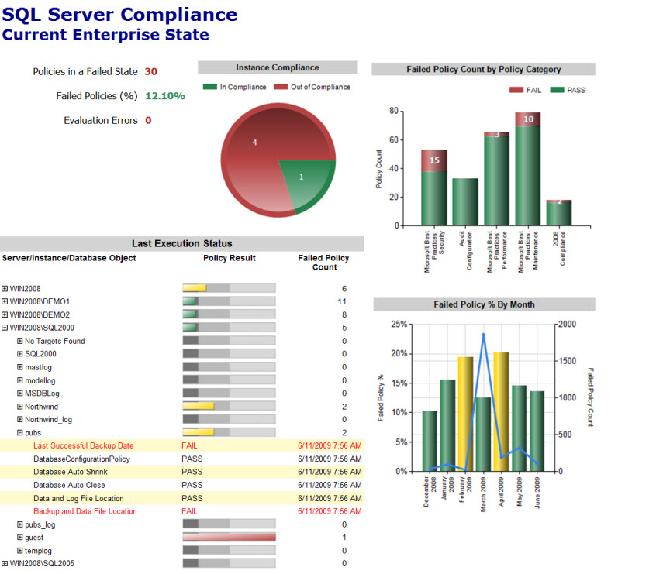
EPM Framework

Slide 12
Questions?
Contact info: email: jorge@sqlchicken.com blog: http://SQLCHICKEN.COM
TWITTER: @SQLCHICKEN feedback:http://speakerrate.com/sqlchicken

